Slide 1
Software Engineering
Module: Web UI Programming
Topic: Java Script

Slide 2
Java Script
The content in this presentation is aimed at teaching learners to:
Describe Java Script as a scripting language
List the advantage of Java Script
Explain fundamental elements of Java Script
Define functions
Deploy event driven code
Get the data from the form controls

Slide 3

Java Script
What is Java Script
Is a scripting language produced by Netscape for use within HTML Web pages.
Loosely based language and it is built into all the major modern browsers.
Lightweight, interpreted programming language
Open and cross-platform

Slide 4
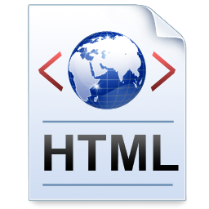

Java Script
Why Java Script?
To overcome HTML Problems:
HTML cannot validate the data at client-side
HTML is static, it cannot react to the events

Slide 5


Java Script
Advantages of Java Script
Provides HTML designers a programming tool.
Can reacts to the events.
Validates the data at client-side.
Can read and change the content of an HTML element.

Slide 6
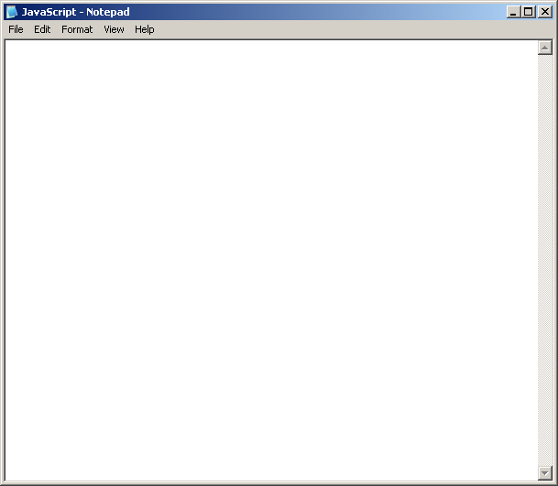
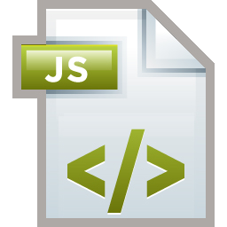
Java Script
Java Script Syntax
<html>
<head>
<script type="text/javascript">
document.write("<p>" + Date() + "</p>");
</script>
</head>
<body>
<h1>My First Web Page</h1>
</body>
</html>
Notes:
A JavaScript consists of JavaScript statements that are placed within the <script>... </script> HTML tags in a web page.
You can place the <script> tag containing your JavaScript anywhere within you web page but it is preferred way to keep it within the <head> tags.
The <script> tag alerts the browser program to begin interpreting all the text between these tags as a script. So simple syntax of your JavaScript will be as follows

Slide 7
Java Script
Java Script Syntax
<html>
<head>
<script type="text/javascript">
document.write("<p>" + Date() + "</p>");
</script>
</head>
<body>
<h1>My First Web Page</h1>
</body>
</html>
Script Tag Attributes
language
type
Notes:
The script tag takes two important attributes:
language: This attribute specifies what scripting language you are using.
type: This attribute is recommended to indicate the scripting language in use and its value should be set to "text/javascript".
Example: type=”text/javascript”

Slide 8
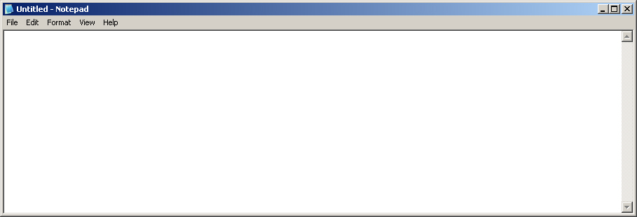
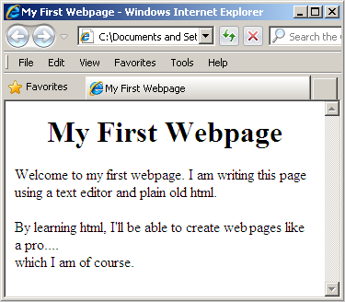
Java Script
First Java Script
<html>
<body>
<script language="javascript" type="text/javascript">
document.write("Hello World!")
</script>
</body>
</html>
Note:
JavaScript ignores spaces, tabs, and newlines that appear in JavaScript programs.
Hello World!

Slide 9
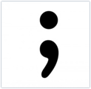

Java Script
Semicolons
Statements in JavaScript are generally followed by a semicolon character, just as they are in C, C++, and Java.
However, Javascript, allows you to omit this semicolon if your statements are each placed on a separate line.
Example code could written without semicolons:
<script language="javascript" type="text/javascript">
var1 = 10
var2 = 20
</script>

Slide 10
Java Script
Semicolons
Semicolons are required when formatted in a single line.
Example:
<script language="javascript" type="text/javascript">
var1 = 10; var2 = 20;
</script>
It is a good programming practice to use semicolons.

Slide 11
Java Script
Case Sensitivity
JavaScript is a case-sensitive language.
Language keywords, variables, function names, and any other identifiers must always be typed with a consistent capitalization of letters.
Example:
Identifier: Time and TIME will have different meanings in JavaScript.
Note:
Care should be taken while writing your variable and function names in JavaScript.

Slide 12
Java Script
Comments
Any text before a // and the end of a line is treated as a comment and is ignored by JavaScript. This is for single line comment.
Any text between the characters /* and */ is treated as a comment. This is for multiple lines comments.

Slide 13
Java Script
Java Script placement in HTML File
JavaScript code can be placed anywhere in an HTML document.
Script in <head>...</head> section.
Script in <body>...</body> section.
Script in <body>...</body> and
<head>...</head> sections.
Script in and external file and then include in <head>...</head> section.
Note:
The preferred way is to include it in the <head> ... </head> section.

Slide 14
Java Script
Java Script Data Types
Three primitive data types:
Numbers
123, 120.50 etc.
Example: var num = 2534;
Strings of Text
“This text string” etc.
Exapmle: var strString = "This is a string";
Boolean
true or false
Ecample: var isMarried = true;

Slide 15
Java Script
Java Script Data Types
Note:
JavaScript is a loosely typed language, the declaration for a string variable, a number and a boolean is same. But it differentiates a string variable, a number and a boolean from the literal value assigned to it and the context of its use.

Slide 16
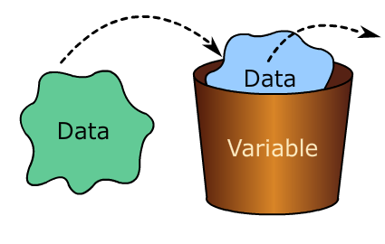
Java Script
Java Script Variables
Variables can be thought of as named containers. You can place data into these containers and then refer to the data simply by naming the container.

Slide 17

Java Script
Java Script Variables
Before you use a variable in a JavaScript program, you must declare it. Variables are declared with the var keyword.
<script type="text/javascript">
var money;
var name;
</script>

Slide 18
Java Script
Java Script Variable Scope
The scope of a variable is the region of your program in which it is defined. JavaScript variable will have only two scopes.
Global Variables
A global variable has global scope which means it can be accessed any where in a JavaScript code.
Local
Variables
A local variable will be visible only within a function where it is defined.
Note:
Function parameters are always local to that function.

Slide 19
Java Script
Java Script Variable Names
Rules for naming JavaScript variables:
You should not use any of the JavaScript reserved keyword as variable name.
Example: Break or Boolean variable names are not valid as variable names.
Variable names should not start with numeral (0-9).
They must begin with a letter or the underscore character.
Example: 123test is an invalid variable name but _123test is a valid one.
Variable names are case-sensitive.
Example, Name and name are two different variables.

Slide 20
Java Script
Java Script Reserved Words
JavaScript Reserved Words
break | case | catch | continue | do
default | delete | else | finally | for
function | if | in | new | return
switch | this | throw | try | typeof
var |  | void | while
Reserve words cannot be used as JavaScript variables, functions, methods, loop labels, or any object names as they have some special meaning.

Slide 21
Java Script
What are Operators
An operator is a symbol that is used to perform an operation.
+
-
/
%
--
&&
>
*
Operators generally work on variables or constants.
Variables
Operators
Constants

Slide 22
Java Script
JavaScript Operators: Can you name these operators?
Can you name these operators?
Arithmetic Operators
+, -, *, /, %, ++, --
Comparison Operators
==, !=, >, <, >=, <=
Logical Operators
&&, ||, !
Bitwise Operators
&, |, ^, ~, <<, >>
Assignment Operators
=, +=, -+, *=, /=
Miscellaneous Opertors
Conditional Operator (?)

Slide 23
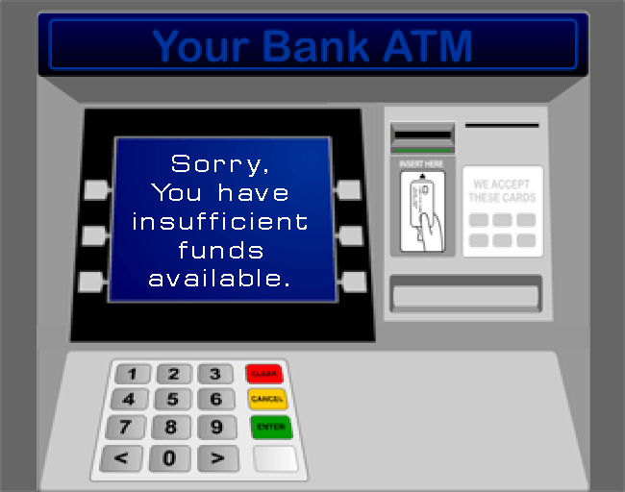
Java Script
Why Conditional Statements?
Very often, in our programs we will get a situation where in we have to execute some statements depending on some condition.
Example
Customer wants to withdraw Rs:5000
Balance availabel Rs:4000
ATM must display : Insufficient Funds
For above situations we use conditional statements like if, if-else.

Slide 24
Java Script
Conditional Statements – Flow control structures
if - Statement
Syntax:
if (expression){
Statement(s) - executed if expression is true
}
Condition
Yes
if else - Statement
Syntax:
if (expression){
Statement(s) - executed if expression is true
}
else{
Statement(s) - executed if expression is false
}
Condition
No
Yes

Slide 25
Java Script
Conditional Statements – Flow control structures
Expression
Switch Statement
Syntax:
switch (expression)
{
case condition 1: statement(s)
break;
case condition 2: statement(s)
break;
...
case condition n: statement(s)
break;
default: statement(s)
}
Case 1
Statements List 1
Case 2
Statements List 2
Case 3
Statements List 3
default
Statements List n

Slide 26
Java Script
Conditional Statements – Looping Control Structures
while
Syntax:
while (expression){
Statement(s) - executed if expression is true
}
Condition
No
Yes
do while
Execute the block of statement
Syntax:
do{
Statement(s) to be executed;
} while (expression);
Condition
Yes
No

Slide 27
Java Script
Conditional Statements – Looping Control Structures
for
Syntax:
For (initialization; test condition; iteration statement){
Statement(s) to be executed if test condition is true
}
Advanced ‘for’
Syntax:
for (variablename in object){
statement or block to execute
}

Slide 28
Java Script
How to define a function?
The most common way to define a function in JavaScript is by using the function keyword, followed by a unique function name, a list of parameters (that might be empty), and a statement block surrounded by curly braces.
Syntax:
<script type="text/javascript">
function functionname(parameter-list)
{
// statements
}
</script
Syntax for calling a function:
<script type="text/javascript">
sayHello();
</script>

Slide 29
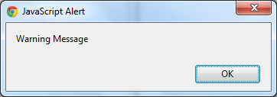
Java Script
Dialog Boxes
Alert Dialog Box
Used to give a warning message to the users
alert("Warning Message");

Slide 30
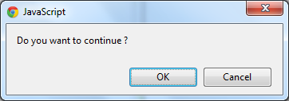
Java Script
Dialog Boxes
Confirmation Dialog Box
Used to take user's consent on any option.
Displays a dialog box with two buttons:
OK and Cancel.
confirm("Do you want to continue ?");

Slide 31
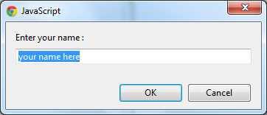
Java Script
Dialog Boxes
Prompt Dialog Box
Prompts the user for a single input
var input = prompt("Enter your name : ", "your name
here");

Slide 32
Java Script
Page Printing
The JavaScript print function window.print() will print the current web page when executed.
<input type="button" value="Print“ onclick="window.print()"/>

Slide 33
Java Script
Page Redirection
Redirects your site visitors to a new page
window.location="http://www.newlocation.com";

Slide 34

Java Script

